Slide 1

Implementing AdaBoost for Predicting
Online Shoppers' Purchase Intentions
Team: 404 Not Found
Diksha Krishnan, Xinyu Zhou, Shen Yu, Dongyan Sun
December 9, 2024

Slide 2

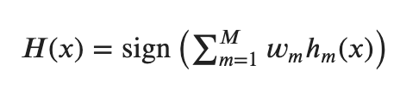
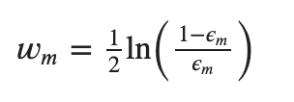

Math Behind AdaBoost
Equations of AdaBoost
Representation
Loss Function
Optimizer
1. the weak leaner is Disicion Stumps
2. a weighted sum of the predictions from all weak learners
3. smaller error leads to a larger weight, indicating a better learner
1. minimizes an exponential loss function which ensures that large errors (misclassified points) contribute more significantly to the loss
2. encouraging the model to focus on correcting them

Slide 3
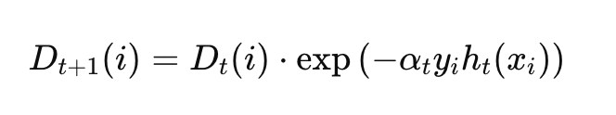
Equations of AdaBoost
Math Behind AdaBoost
Representation
Loss
Optimizer
adjusting the weights of weak classifiers and sample points to minimize the classification error

Slide 4
Numerical Techniques
Exponentiation of Weight Updates
Normalization of Weights
Logarithm of Alpha Computation
1. ensures that the weight updates are correctly scaled
2. prevent underflow or overflow errors
ensures weak classifiers with low error receive higher weights
introduces stability, by avoiding extremely large or small values of alpha​
after updating the weights, they are normalized
prevent the weights from growing too large, which could lead to numerical instability

Slide 5
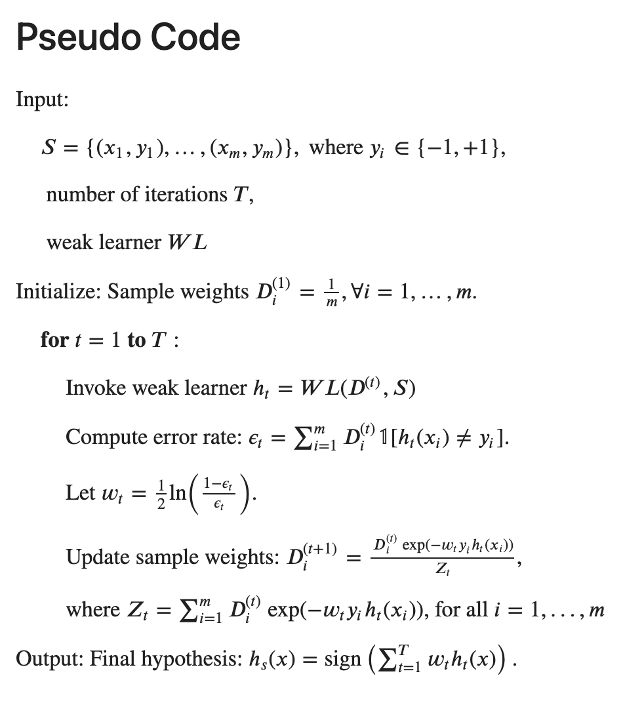

Slide 6
Previous Work We Rreproduced
Y
which online shoppers will end with shopping
{1, -1}
Binary Classification
X
URL information of the pages visited
10 continuous
7 categorical
Preprocess
One Hot Encoder
Standard Scaler
Stratified Split
60% Train
20% Validation
20% Test
Imbalance
Grid Search
7 models
Hyperparameter Tuning
Cross-Validation

Slide 7
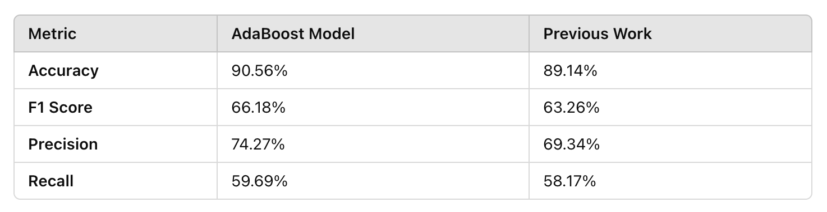
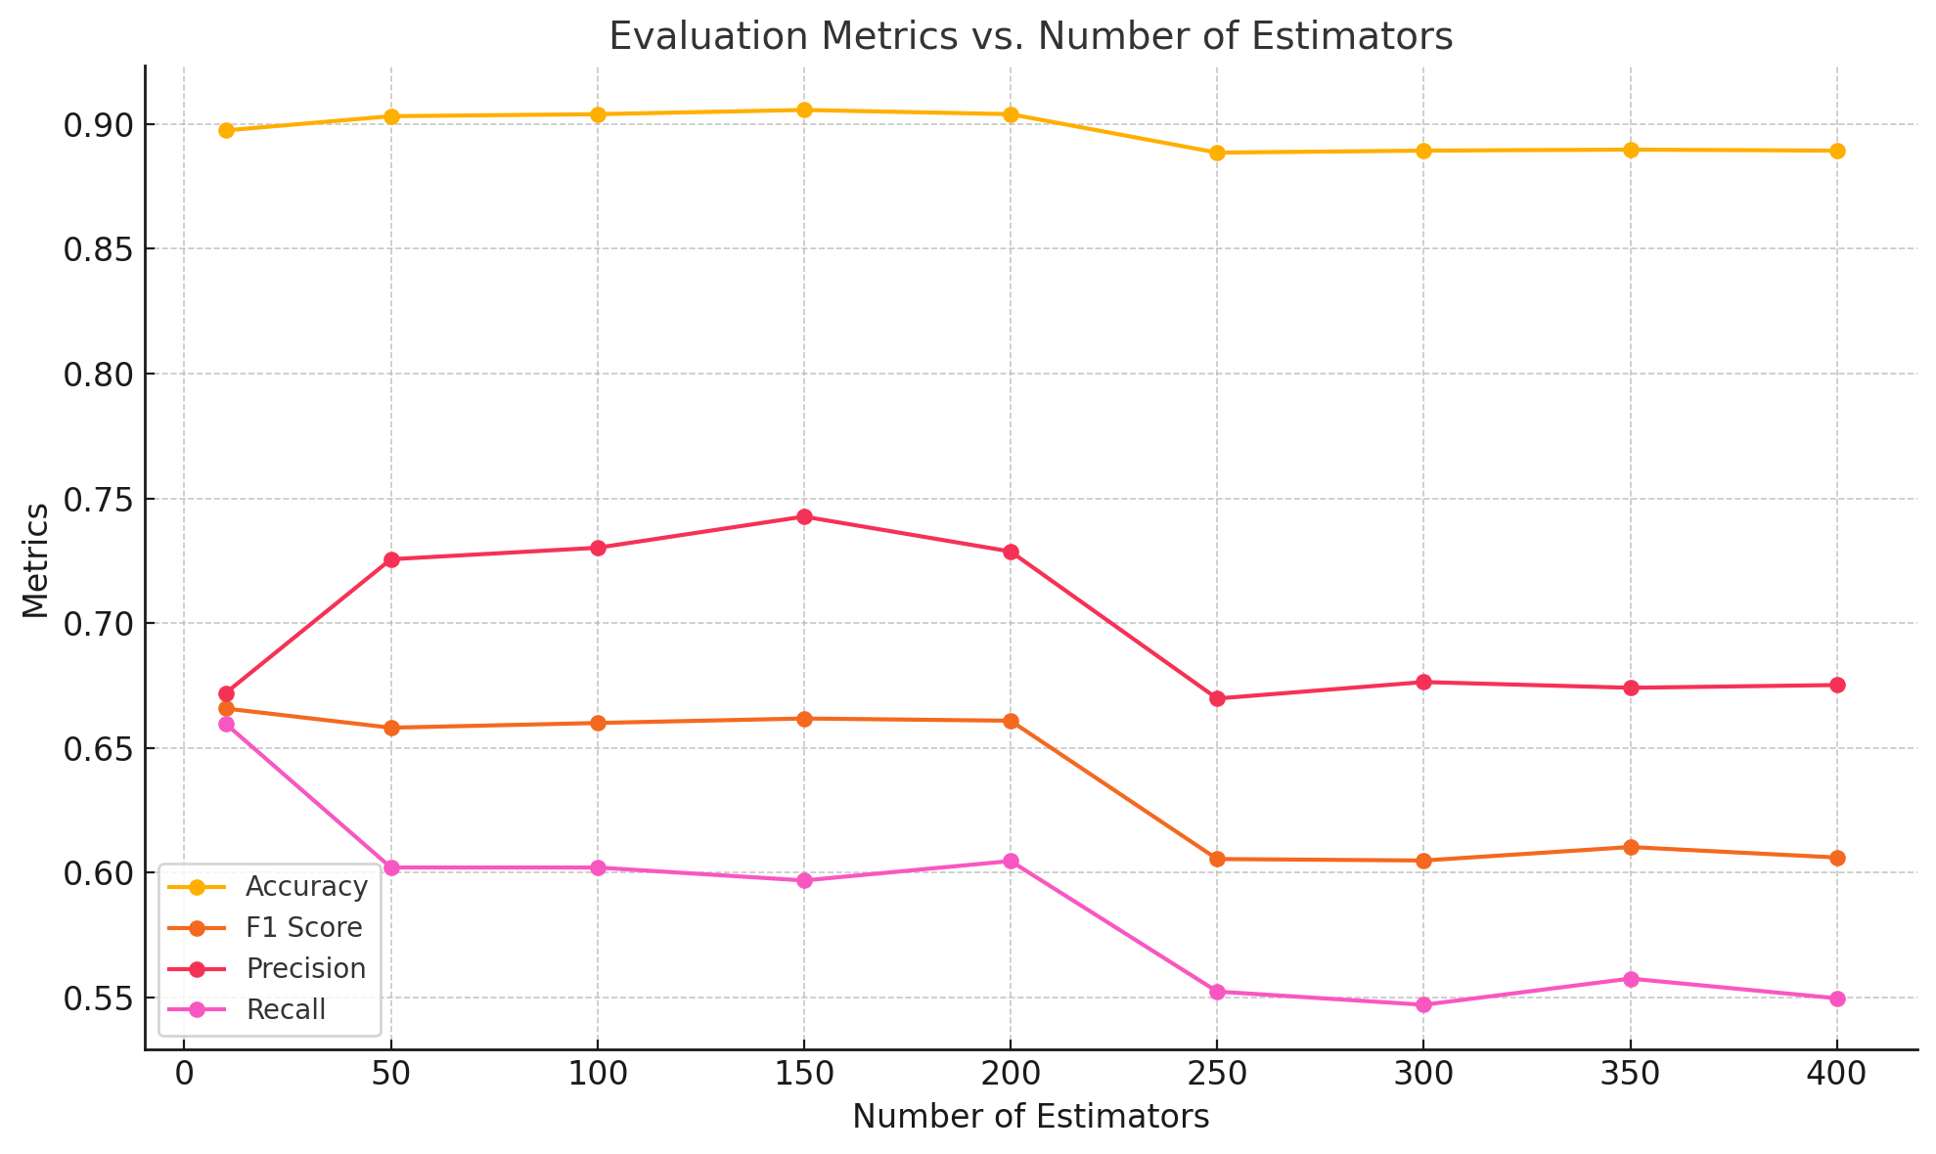
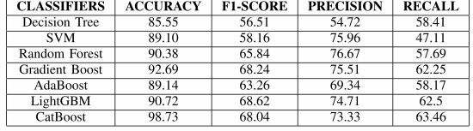
Result
Slightly Higher Accuracy & F1 Score
Imbalance Leads to Low F1 Score
Tune the Number of Estimators:
150: Best Performance 50-100: Underfitting 200-400: Overfitting

Slide 8
Interesting Things about AdaBoost
Simple but Powerful
Balancing Bias and Variance
Error Focusing and Adaptive
combines weak learners (like decision stumps) into a strong ensemble
be implemented easily
works effectively for both classification and regression problems
1. iteratively updating weights for misclassified samples
2. prioritizes correcting mistakes made by earlier weak learners
3. making the model highly adaptive
in the early stages, when bias is high, it focuses on improving the model by giving more weight to the misclassified examples.
as the model improves, focus shifts, balancing bias reduction with variance control.

Slide 9
Challenges when implemented AdaBoost
misclassified samples are given higher weights
if the misclassified samples are just noises or outliers
It can lead to poor performance
Sensitive to Noise
Computation Intensive
Complex Parameter Tuning
requires sequential training of multiple weak learners
slow with large datasets or when using complex base learners
requires careful tuning of hyperparameters, like number of iterations, learning rate
incorrect tuning may lead to underfitting or overfitting
if the weak learners are too complex, the model may overfit the training data

Slide 10
Q&A
References:
1. Shalev-Shwartz, S. and Ben-David, S. (2014) Understanding Machine Learning: From Theory to Algorithms. Cambridge: Cambridge University Press.
2. Swetha, T., R, R., Sajitha, T., B, V., Sravani, J. and Praveen, B. (2024) 'Forecasting Online Shoppers Purchase Intentions with Cat Boost Classifier', 2024 International Conference on Distributed Computing and Optimization Techniques (ICDCOT), Bengaluru, India, 2024, pp. 1-6. doi: 10.1109/ICDCOT61034.2024.10515309.
3. Sakar, C. & Kastro, Y. (2018). Online Shoppers Purchasing Intention Dataset [Dataset]. UCI Machine Learning Repository. https://doi.org/10.24432/C5F88Q.
Githubs:
https://github.com/delio05/AdaBoost

